Slide 1

Quantitative Finance
- Zan Sadiq

Slide 2
Stock Trading- Ticker data
OHLC
2010 – 2020
16 stocks
ALIBABA
DODGE
HILTON
IBM
MICROSOFT
GOOGLE
GOLD
EURO
PINTEREST
UPLAND
CASTLE
STRYKER
APPLE
TOYOTA

Slide 3


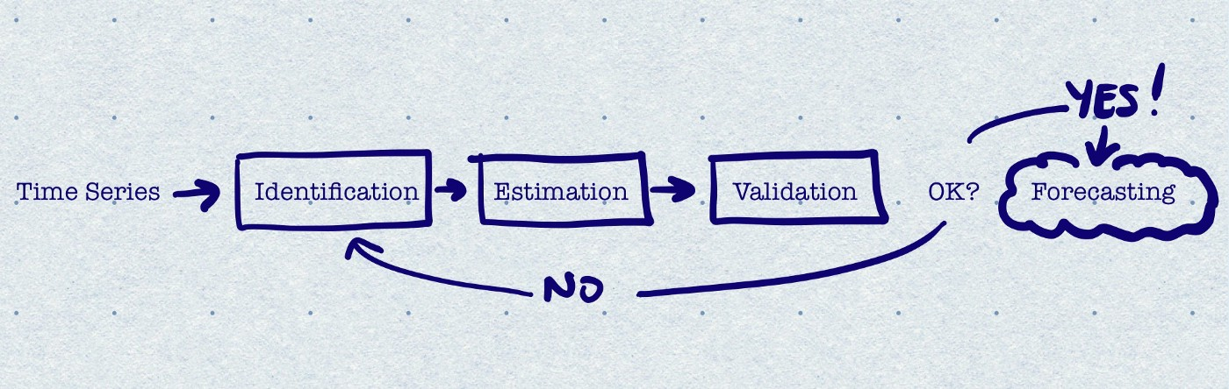




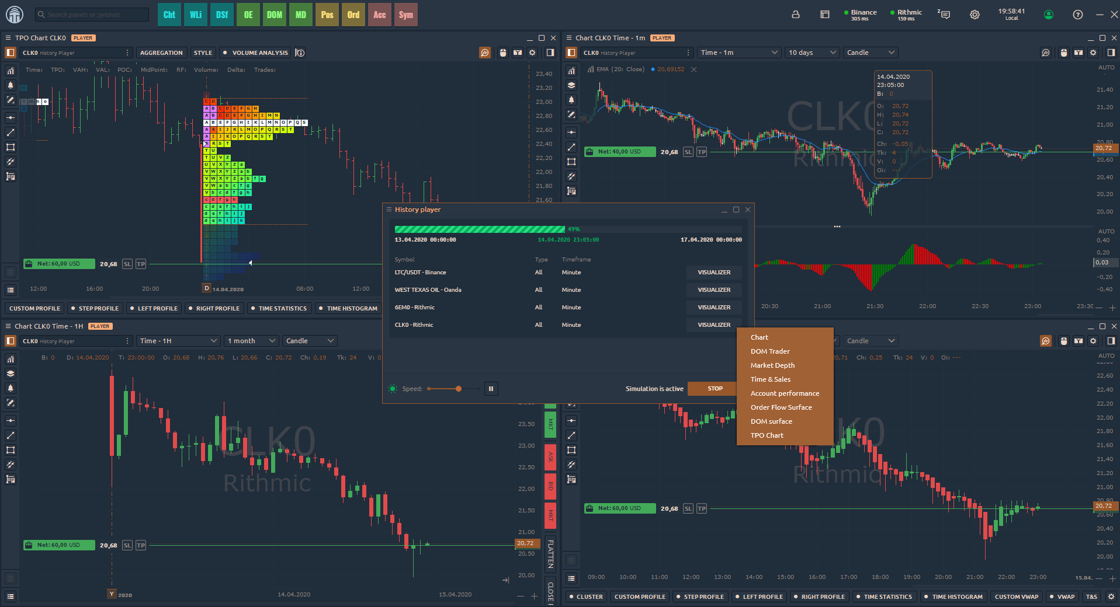

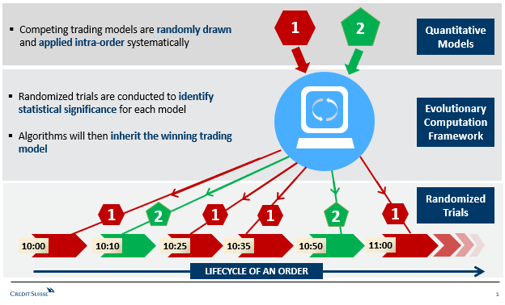
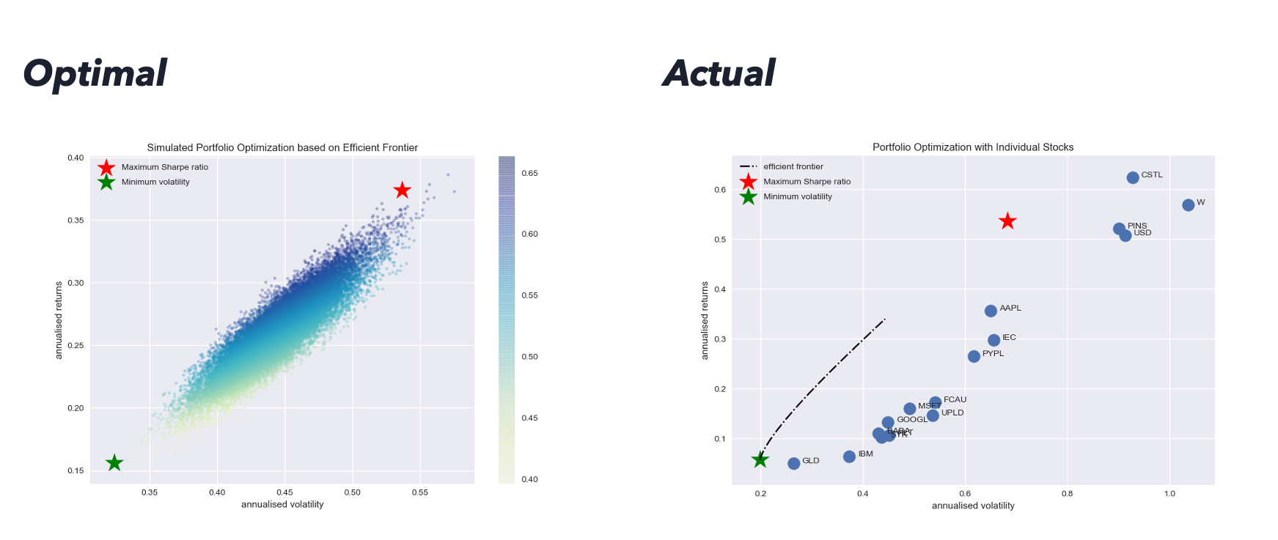
Machine Learning
Parameter Optimization :
4,000 models
Cloud storage and compute
Predict Gaussian Filter
&
Generate Signals
Historical Price Data
AI
~ 6.3X Returns
Portfolio Backtesting
Trading Execution
Ticker | Holding | $ | Total | Return
AAPL | 500 | 10000 | 10000 | 1
IBM | 100 | 15000 | 11000 | 1.5
GOOGL | 500 | 12000 | 12000 | 1.2
Portfolio Optimization

Slide 4
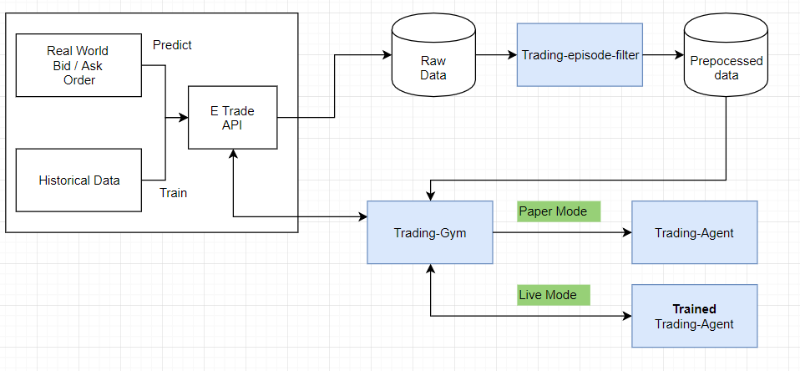
Live Framework:
Reinforcement Learning

Slide 5
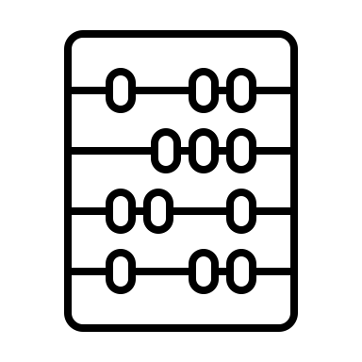

Strategy
Machine Learning
Trading
Apply Gaussian Filter to price
𝚫 pct_change{signal} >= [.05]
Moving Averages- short & long

Slide 6
Signal Processing
Gaussian Filter
FindPeaks()
FindTroughs()

Slide 7
Returns
Buy
Sell
Cumulative Total
Price
Signal

Slide 9
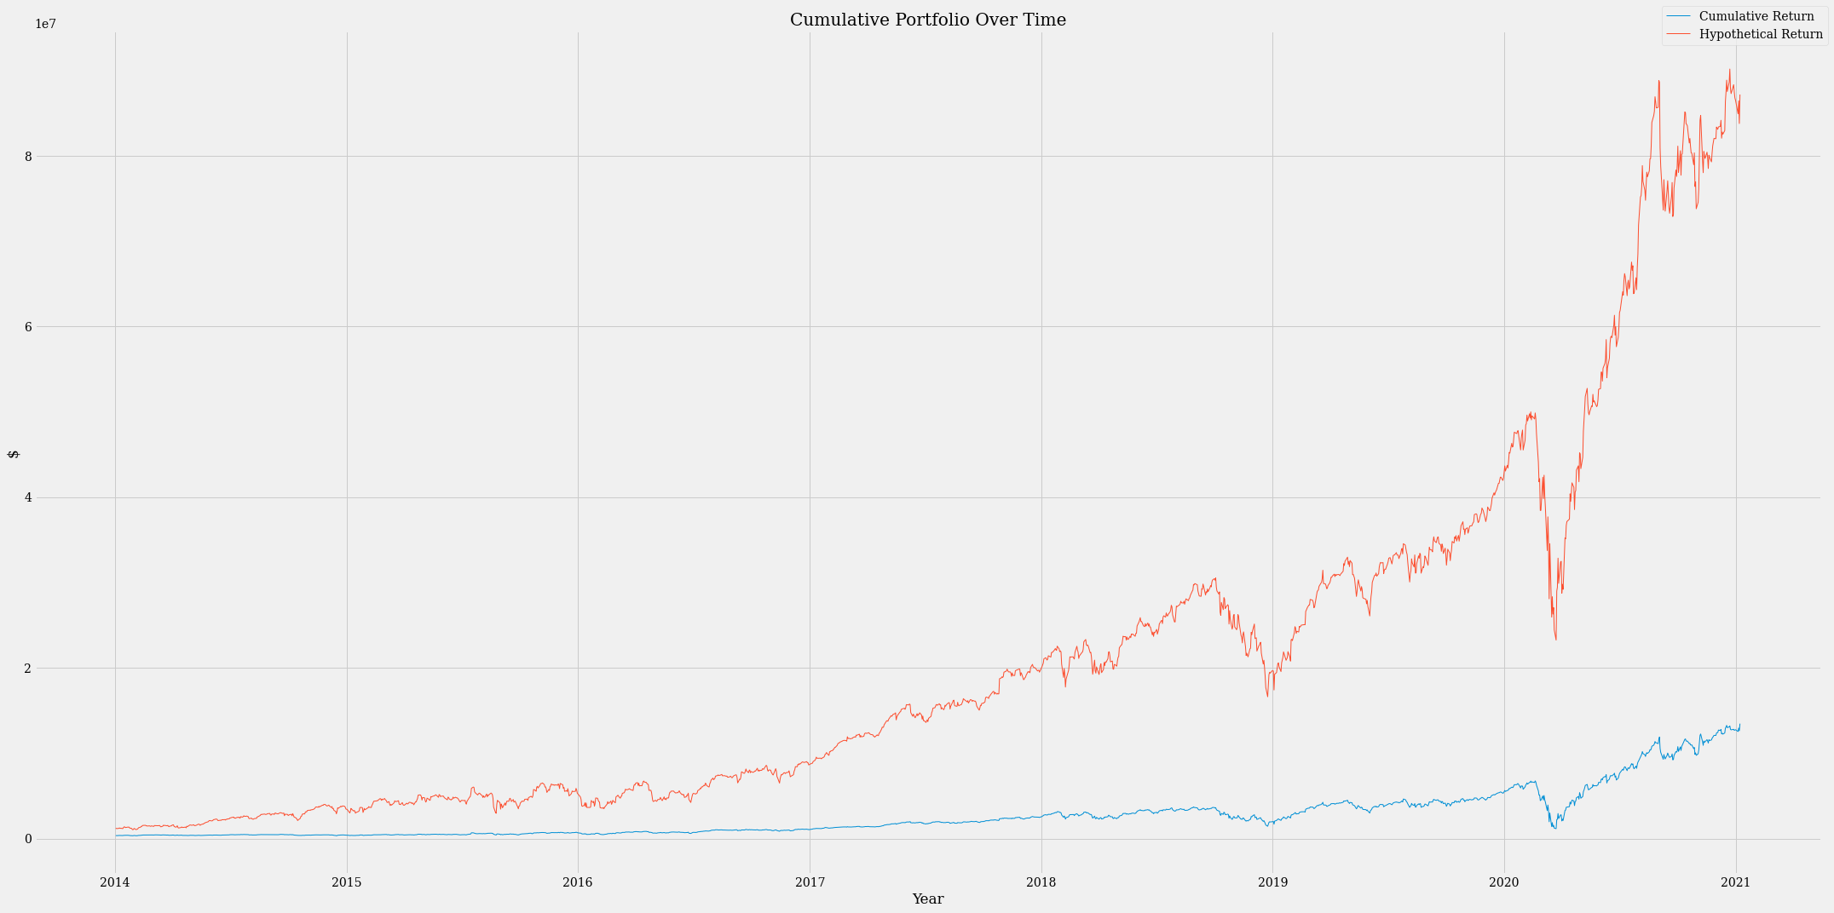

Slide 10
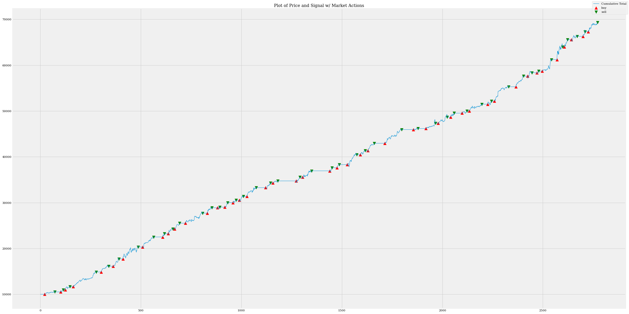

Slide 11
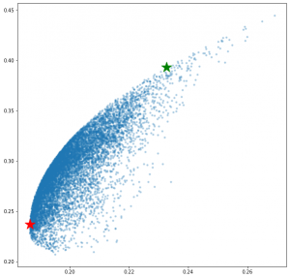
Optimization
“Mean-Variance Analysis” – Modern Portfolio Theory
H. Markowitz
MPT assumes that all investors are risk-averse, i.e, if there is a choice between low risk and high risk portfolios with the same returns, an investor will choose one with the low risk.
So, what is the MPT all about?
MPT encourages diversification of assets. It says that a high variance asset A if combined with diverse assets B and C, where A, B and C have little to no correlation, can give us a portfolio with low variance on returns.

Slide 12
Portfolio

Slide 13
Cumulative Returns

Slide 14
Appendix

Slide 15
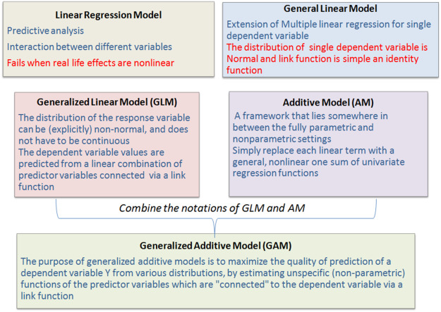
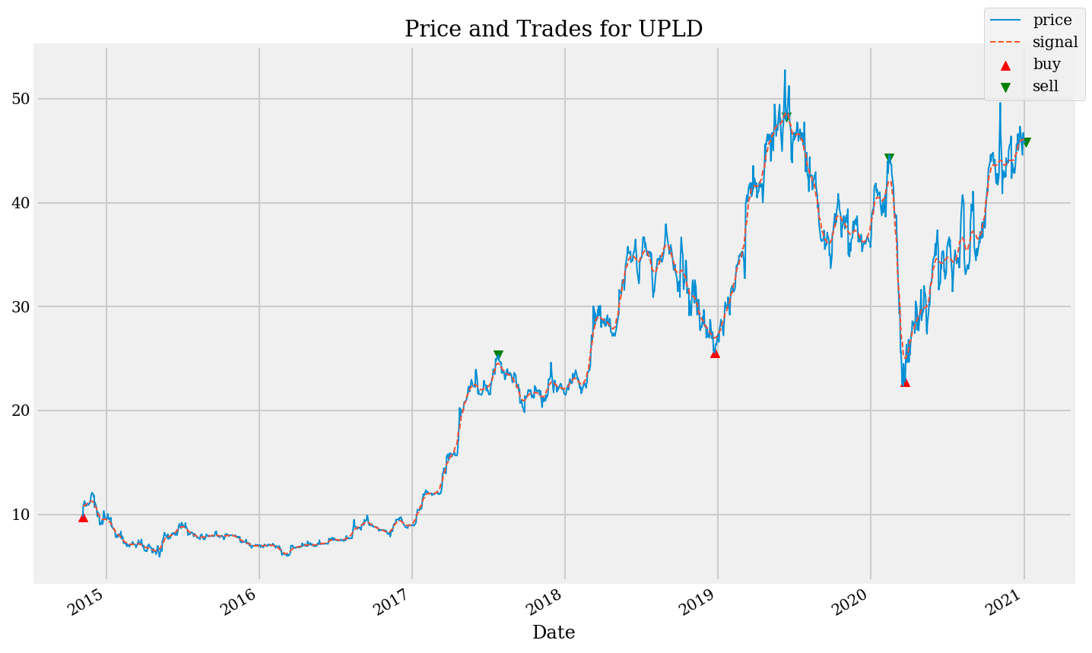
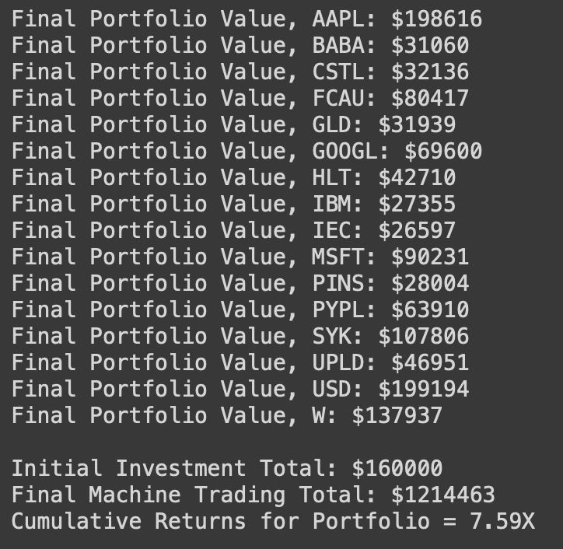
Generalized Additive Models

Slide 16
